Slide 1
Microwave Devices E511
Lecture 2
Amr Al.Awamry

Slide 2
Agenda
Plan waves in Lossless Medium
Plan waves in general lossy Medium
In Good conductor
General Plan wave Equation Solution
Plan wave Polarization
Enegry & Power
Reflection and transmission coefficients

Slide 3
Plan waves in Lossless Medium
Helmholtz Equation in x direction
Leads to
Phase velocity condition
Leads to
wavelength
Magnetic field

Slide 4
Plan waves in general lossy Medium
Conductivity NOT equal ZERO
In a lossy Dielectric
Magnetic Field

Slide 5
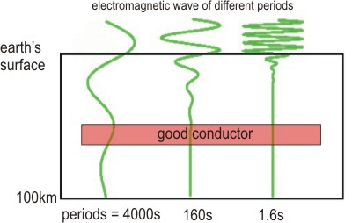
In Good conductor
Skin Depth

Slide 6
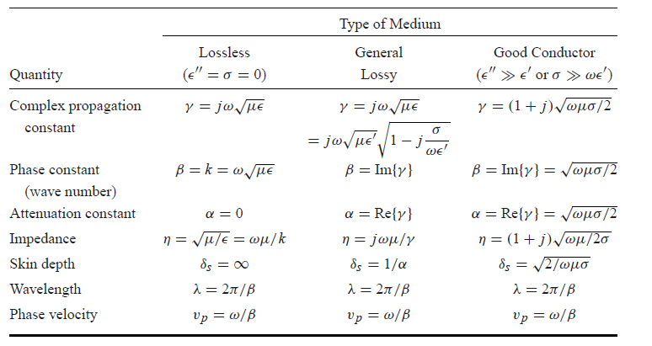
Plan wave summary in diff. media

Slide 7
General Plan wave Equation Solution

Slide 8
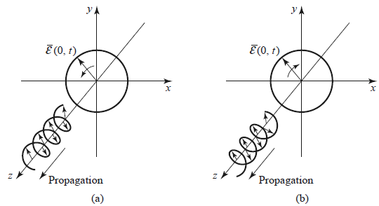
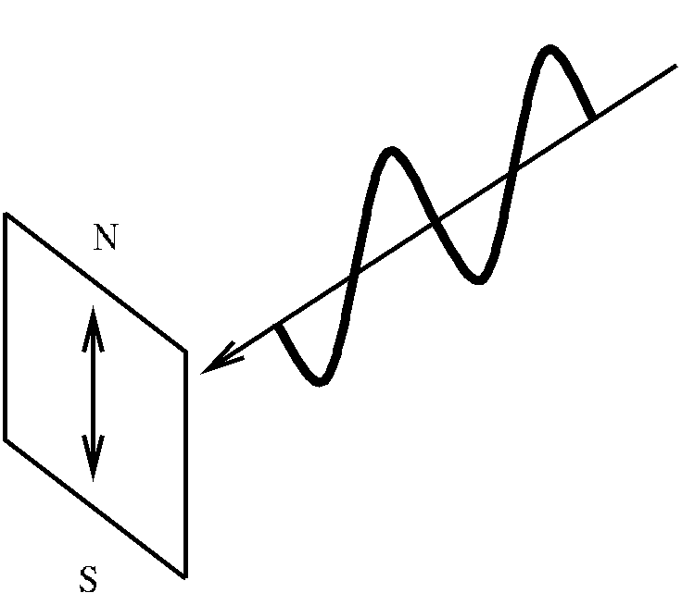
Plan wave Polarization
If E₁ and E₂ are REAL
Then it’s called Linear Polarization
If E₂ = -jE₁ then it’s called RHCP
If E₂ = jE₁ then it’s called LHCP

Slide 9
Enegry & Power

Slide 10
Enegry & Power cont.
Poynting Vector
Losses in Medium
Stored Energy
where

Slide 11
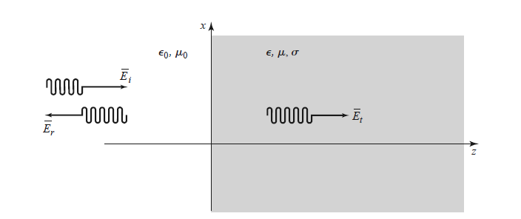
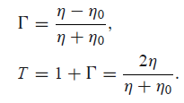
Reflection and transmission coefficients

